Slide 1
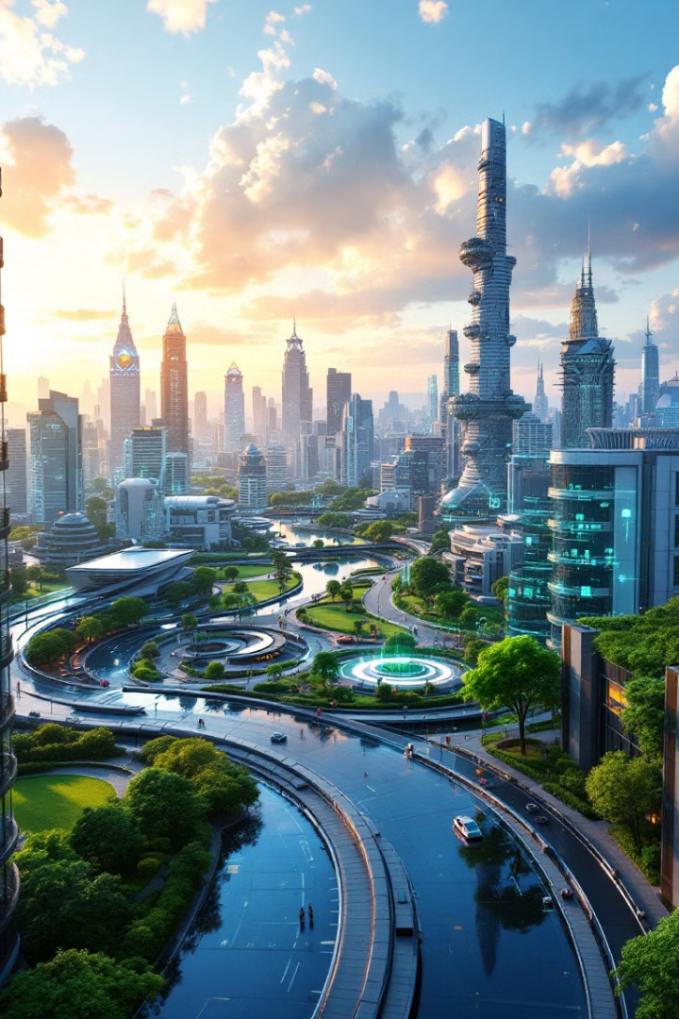
Problematic statement, Aim, Introduction, Objective, Methodology, Scope, Block Diagram, Analysis Data, Results, and Conclusions.
REVOLUTIONIZING ENVIRONMENTAL MONITORING: HARNESSING AI FOR A SUSTAINABLE FUTURE
1
Notes:
1

Slide 2
Problematic Statement
Slow and Costly
Limited Resolution
Inefficient Data
Traditional methods are slow and costly.
Traditional methods provide limited resolution.
Data collection delays responses to critical issues.
Current systems struggle with vast data. Manual water testing in the Amazon misses crucial pollution events.
2
Notes:
2

Slide 3


Aim
1
Real-Time Data
Provide real-time, accurate data.
2
Scalable Platform
Create a scalable, adaptable platform.
3
Transform Monitoring
Transform environmental monitoring using AI.
4
KPI: Data Reduction
40% data processing time reduction.
Our goal is proactive environmental management. We aim for sustainable practices across industries.
3
Notes:
3

Slide 4
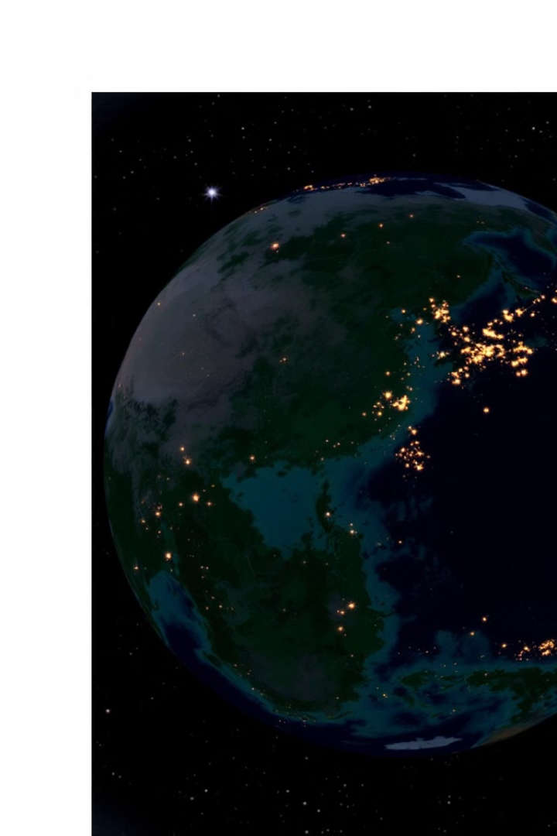
Introduction: AI in Environmental Monitoring
Environmental Challenges
Limitations
Traditional methods need innovation.
Climate change, pollution, resource depletion.
AI Potential
AI applications in monitoring.
Market analysis shows 25% annual growth. AI offers solutions to overcome limits in traditional methods.
4
Notes:
4

Slide 5

Objective: Key Deliverables
1
AI Algorithms
Develop algorithms for real-time data analysis.
2
User-Friendly Platform
Create platform for data visualization and prediction.
3
Pilot Studies
Validate AI system effectiveness.
4
Success Metrics
90% accuracy in anomaly detection.
Our objectives are to visualize data. We will report and create predictive models. We will validate our system.
5
Notes:
5

Slide 6
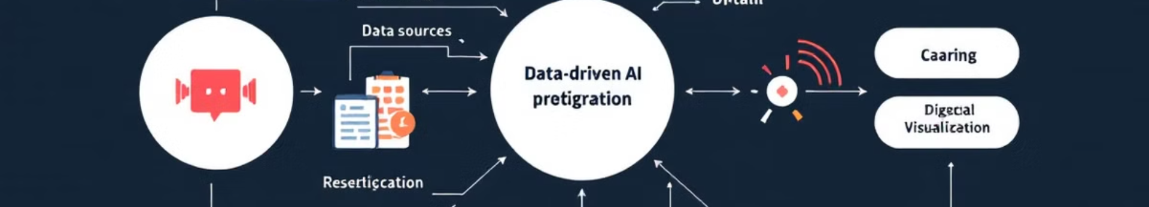




Methodology: AI System Architecture
Data Acquisition
Data Preprocessing
AI Model Development
Model Deployment
Integrate data from satellites, IoT, drones.
Clean, normalize using PCA and wavelet transforms.
Implement AI models on cloud.
Train machine learning models.
Our methodology is multi-faceted. We'll use CNN, RNN, SVM for specific tasks.
6
Notes:
6

Slide 7
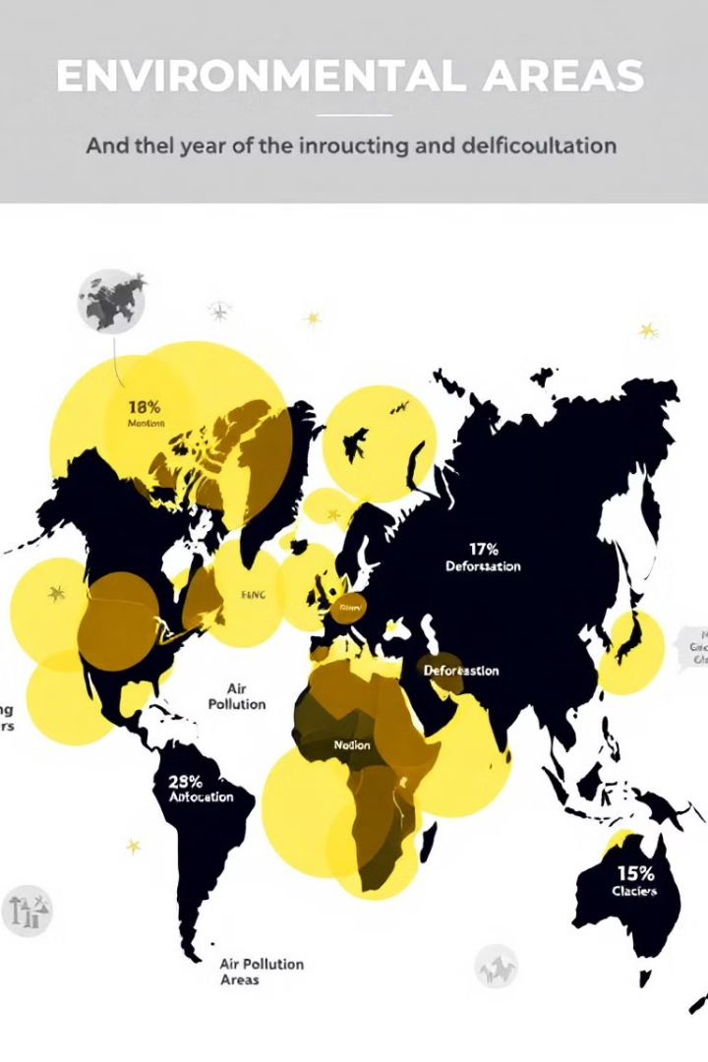



Scope: Applications and Boundaries
Air and Water
Deforestation
Biodiversity
Air and water quality monitoring.
Deforestation detection, forest health.
Biodiversity, species identification.
Applications include climate change impact. Our focus is on scalable, open-source, ethical solutions.
7
Notes:
7

Slide 8
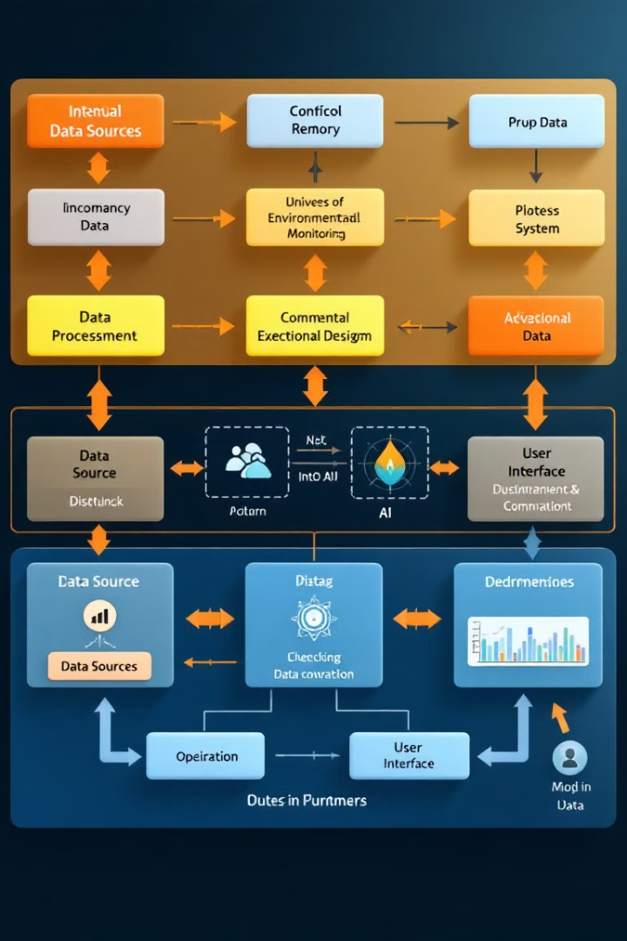
Block Diagram: System Overview
Data flow goes from environmental sensors. The data then goes to AI-driven insights. Key components are data ingestion and the AI engine.
8
Notes:
8

Slide 9
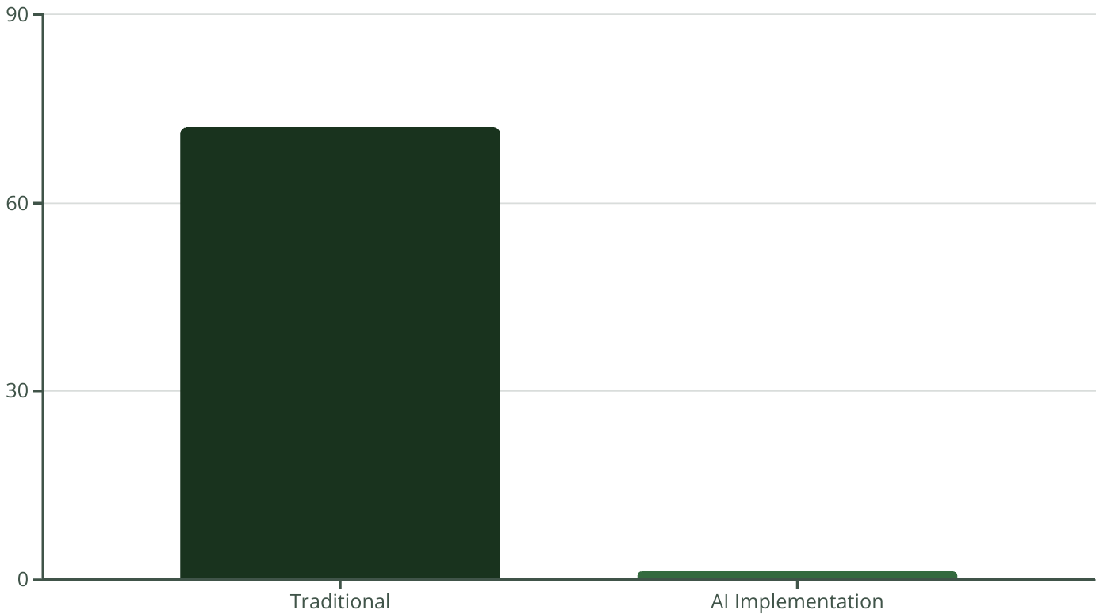
Analysis Data: Example Case Study
9
AI detects pollution, predicts air quality. Before AI, alerts took 72 hours. After AI alerts were sent in real-time.
Notes:
9

Slide 10




Results and Conclusions
1
Key Findings
Scaling Potential
2
4
Action
3
Collaboration
AI systems address environmental challenges. We need researchers, policymakers, and industry to work together. Invest in AI for a sustainable future.
10
Notes:
10

